Slide 1
From Data to Action: Reproducible Analytical Pipeline (RAP) for Rapid, Sustained and Statistically-Significant Improvement in MRSA Admission Screening Compliance.

Slide 2









Meet the Team
Daniel Weiand; Paul Bradley; Caroline Cullerton; Geoff Dines;
Joanne Field; Peta Le Roux; Jamie Lupton; Julie Samuel; Chris Plummer

Slide 3
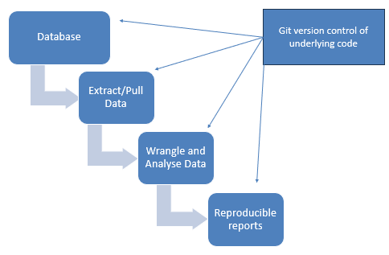
What is a RAP?
A Reproducible Analytical Pipeline (RAP) comprises a set of principles and practices that create faster, more robust, and transparent analytical processes

Slide 4
Challenge | Benefit | How RAP Solves It
Slow reporting cycles | Reduced time to insight | Automating data extraction, processing, and output eliminates manual steps.
Lack of trust in data | Enhanced trust in data | Version-controlled code ensures the pipeline is fully auditable and consistent.
Difficulty replicating findings | Improved reproducibility and transparency | Code acts as a permanent recipe for anyone to independently achieve identical outputs.
Case-finding complexities | Better resource allocation | Programmatic, rule-based filtering automatically targets specific cohorts of interest.
Subjective decision-making | Evidence-based decision-making | Repeatable analysis ensures strategic choices are based on evidence rather than assumptions.

Slide 5
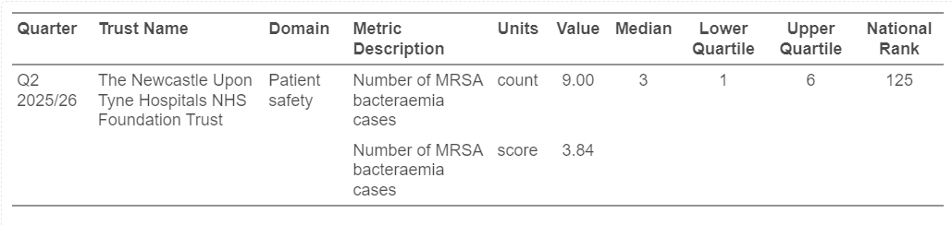
Problem description
MRSA blood stream infection (BSI; bacteraemia):
National frameworks mandate organisation-level reporting of cases
Q2 25/26, NUTH was ranked
… 22nd (out of 134), in segment 2 of the dashboard
… 125th (out of 134) for the metric 'Number of MRSA bacteraemia cases’

Slide 6
Intervention / Strategy | RAP Role | Impact of RAP
Enhanced Surveillance & Reporting | ✅ Direct | Automatically processes pathology and admission data to generate timely, patient-level intelligence.
Universal Screening & Decolonisation Protocols | ✅ Direct | Programmatically evaluate compliance with MRSA policy, including admission screening practices
Prudent Antimicrobial Stewardship | ✅ Direct | Facilitate earlier review of antimicrobial prescriptions in MRSA-positive patients
Innovation & Technology | ✅ Direct | RAP allows for automated, patient-level surveillance of key assurance measures, and rapid sharing of results
Leadership Engagement & Governance | ✅ Direct | Delivers fully auditable, trustworthy, timely and immediately actionable data to key stakeholders
Staff Education & Competency | 🔗 Indirect | Ward-level data allows educators to target training and intervention where it is objectively needed most
Optimised Hand Hygiene Compliance | ❌ None | Physical clinical practice. RAP cannot monitor bedside compliance.
Rigorous Environmental Cleaning | ❌ None | Physical clinical practice. RAP cannot clean a ward.

Slide 7
Problem description
At NUTH, MRSA admission screening is mandated for practically most inpatients
Screening must be undertaken between:
[18 weeks preceding admission] –
[admission date]
Prior to this project, MRSA admission screening compliance levels were effectively unknown at NUTH.

Slide 8

Normalisation Process Theory (NPT)
Feedback/
‘Reflexive monitoring’
Routine embedding/
‘Normalisation’
Shared understanding/
‘Coherence’
Monitoring and report on performance
Improved practice
Per Nilsen [2024]
Improve understanding

Slide 9
Aims
To develop and implement a RAP
…That triangulates data from different silos
…To prospectively evaluate, report, monitor and improve compliance with MRSA admission screening practices

Slide 10
Setting
Newcastle upon Tyne Hospitals NHS Foundation Trust (NUTH)
Major tertiary care NHS provider
Approximately 16,000 staff
Serving around two million patient contacts annually.
The microbiology laboratory at NUTH is fully UKAS-accredited to ISO 15189:2022 (18,19)

Slide 11
RAP
RAP
Data extraction, on a weekly basis
Data wrangling (inc. cleaning, quality-checks, and analysis)
Final output: standardised HTML format report,
Automatically uploaded to a secure, central intranet hub
from secure data warehouse (DWH), using SQL and R programming.
using modular, re-usable, git version-controlled code
using R programming .
generated using Quarto.
data science intranet site

Slide 12
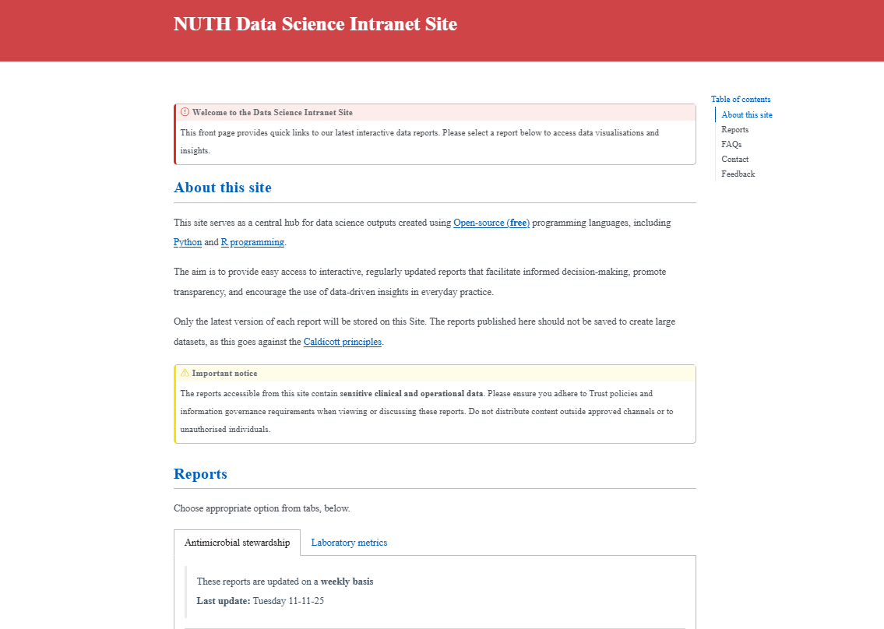

Slide 13
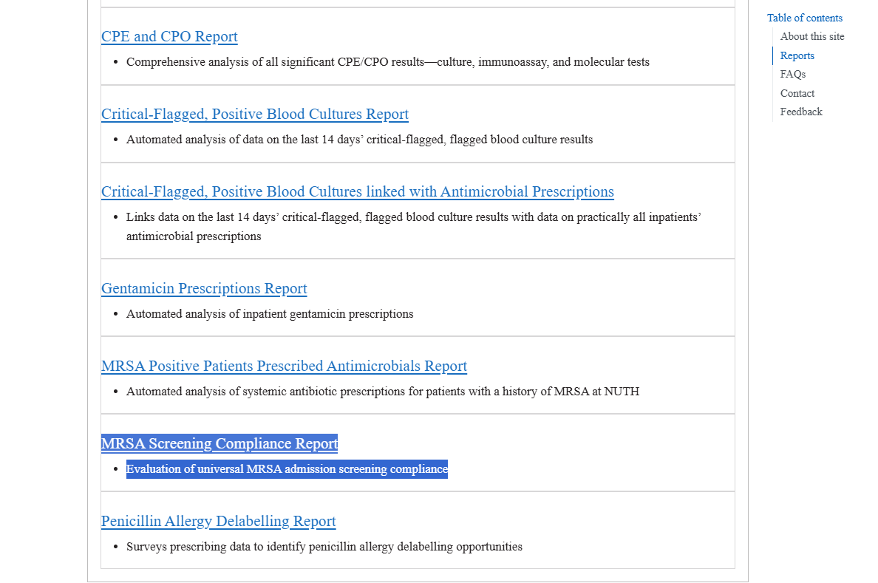

Slide 14
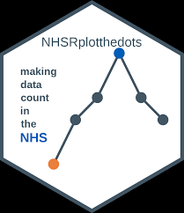
Approach to Assessing Impact
Design: Prospective weekly surveillance study
Systematic outcome measurement commenced on 07/01/2025
Time series analysis using Statistical Process Control (SPC) methods used to detect meaningful changes in compliance

Slide 15
Selection of participants (pragmatic approach)
Inclusion criteria:
all current inpatients at NUTH; with
length of stay of at least 24 hours; and
prescribed a new inpatient medication within the previous 7 days.
Exclusion criteria:
admitted >6 weeks prior to the date of analysis; or
exempt from MRSA admission screening as per policy.

Slide 16
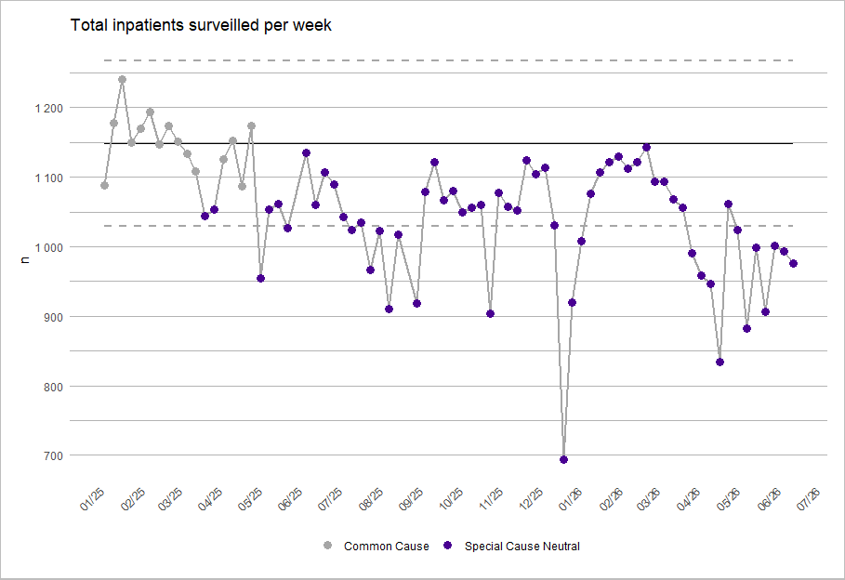
Results
Between 07/01/2025 and 16/06/2026
(~ 1.5 years)
Total inpatients surveilled per week (n)

Slide 17
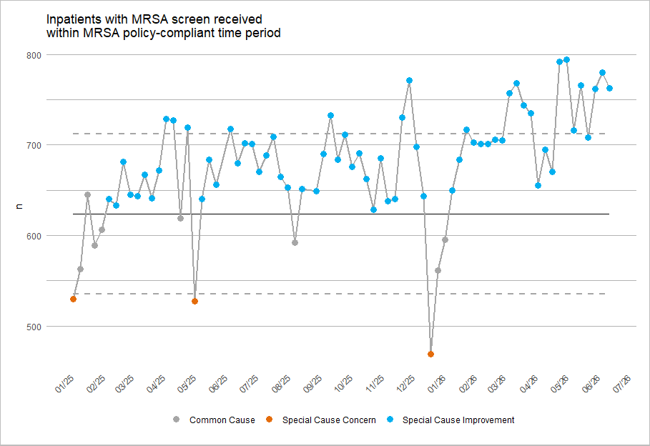
Impact of RAP on screening
Between 07/01/2025 and 16/06/2026
(~ 1.5 years)
Inpatients compliant with MRSA admission screening (n)
(higher is better)

Slide 18
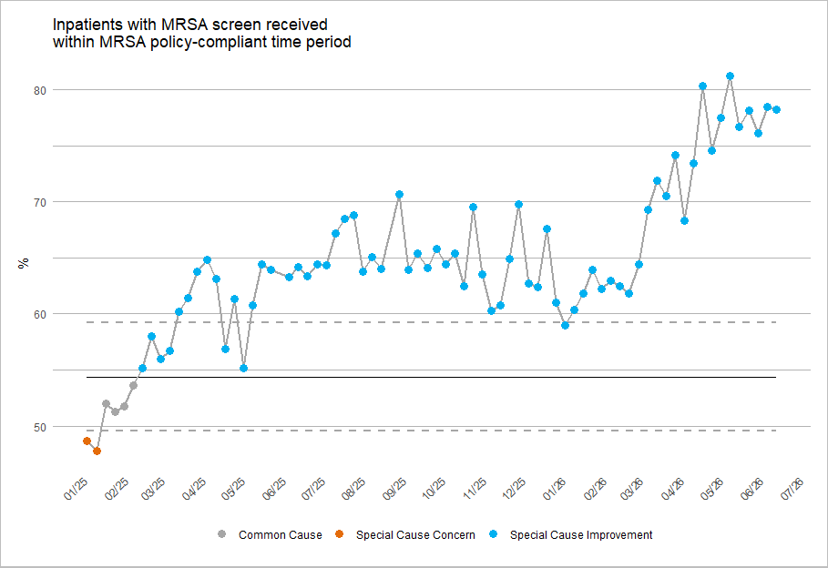
Impact of RAP on screening
Between 07/01/2025 and 16/06/2026
(~ 1.5 years)
Compliance with MRSA admission screening (%)
(higher is better)

Slide 19
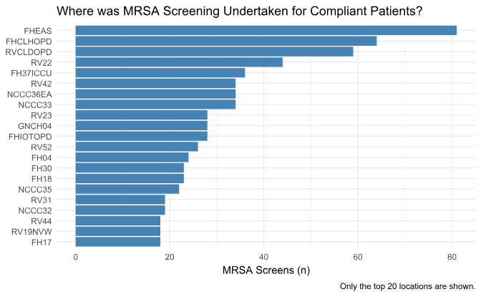
Data for the week ending 03/02/2026
Time 0
RVAS doesn’t feature in the top 10 wards
Improvements in MRSA admission screening compliance driven by RVI Assessment Suite (RVAS) staff
Number of MRSA screens received per location (n)

Slide 20
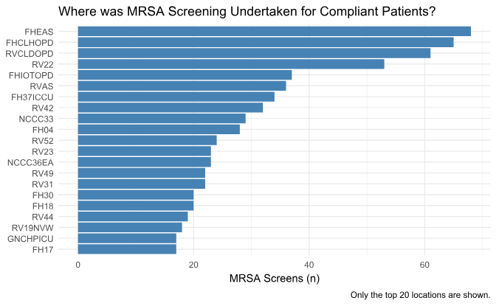

Data for the week ending 10/02/2026
Time +1 week
RVAS is 6th
Improvements in MRSA admission screening compliance driven by RVI Assessment Suite (RVAS) staff
Number of MRSA screens received per location (n)

Slide 21
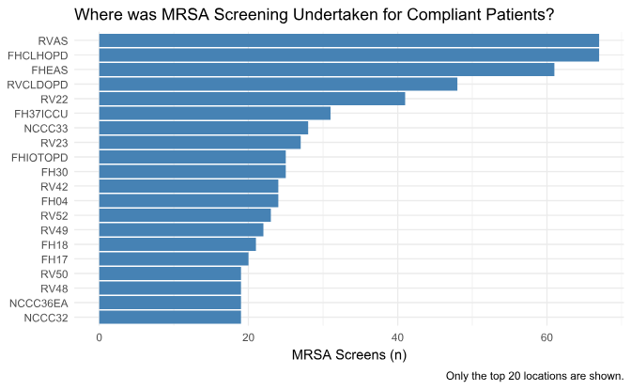
Data for the week ending 17/02/2026
Time +2 weeks
RVAS is joint-top screening location
Improvements in MRSA admission screening compliance driven by RVI Assessment Suite (RVAS) staff
Number of MRSA screens received per location (n)

Slide 22
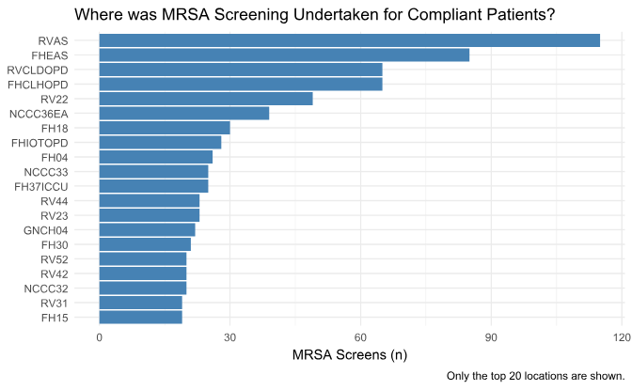
Data for the week ending 24/02/2026
Time +3 weeks
RVAS is number 1 screening location
Improvements in MRSA admission screening compliance driven by RVI Assessment Suite (RVAS) staff
Number of MRSA screens received per location (n)

Slide 23
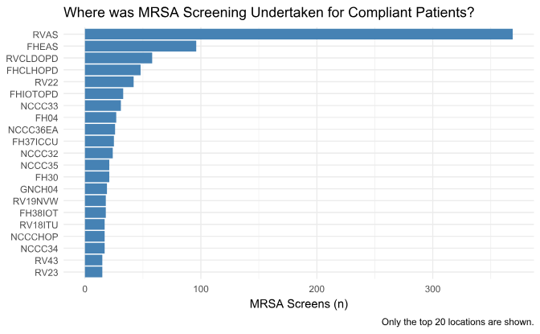

Data for the week ending 16/06/2026
Time +4 months
RVAS is now far-and-away the number 1 screening location
Improvements in MRSA admission screening compliance driven by RVI Assessment Suite (RVAS) staff
Number of MRSA screens received per location (n)

Slide 24
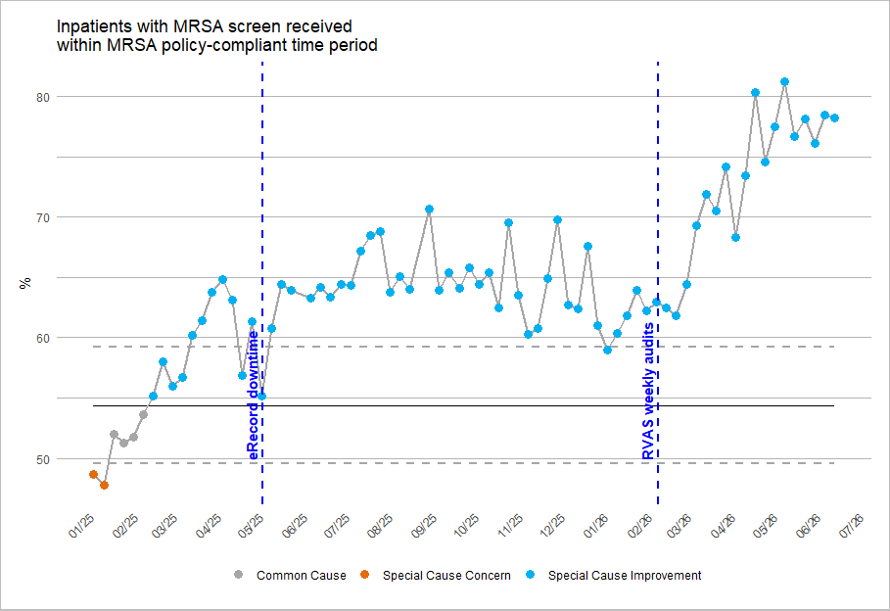
Impact of RAP on screening + locally-driven QI
Between 07/01/2025 and 16/06/2026
(~ 1.5 years)
Compliance with MRSA admission screening (%)
(higher is better)
- annotated

Slide 25
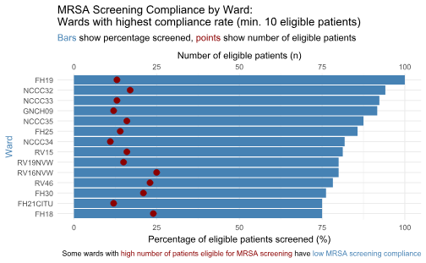
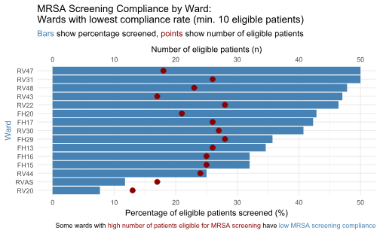
Best performers
Requiring improvement
Data for the week ending Tuesday 11/11/2025

Slide 26
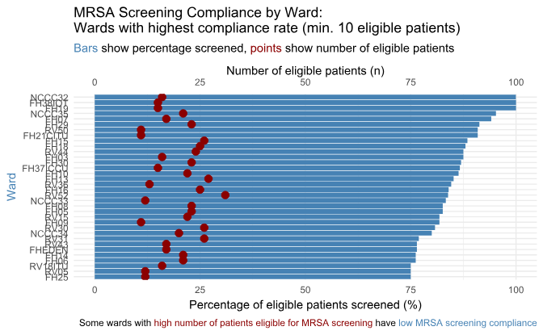
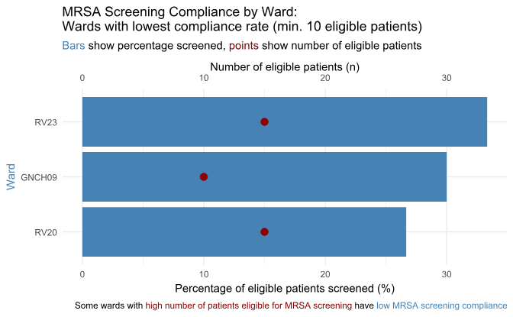
Best performers
Requiring improvement
Data for the week ending Tuesday 23/06/2026

Slide 27
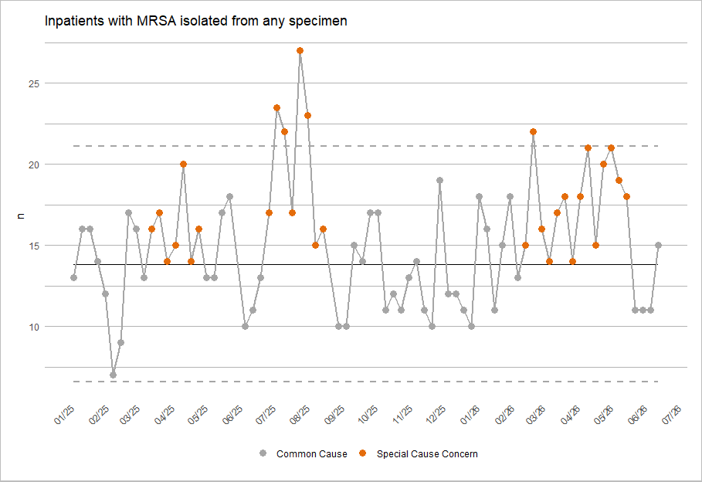
Impact of RAP on MRSA rates
Between 07/01/2025 and 16/06/2026
(~ 1.5 years)
Inpatients with MRSA isolated from any specimen type
(prevalence)
(lower is better)

Slide 28
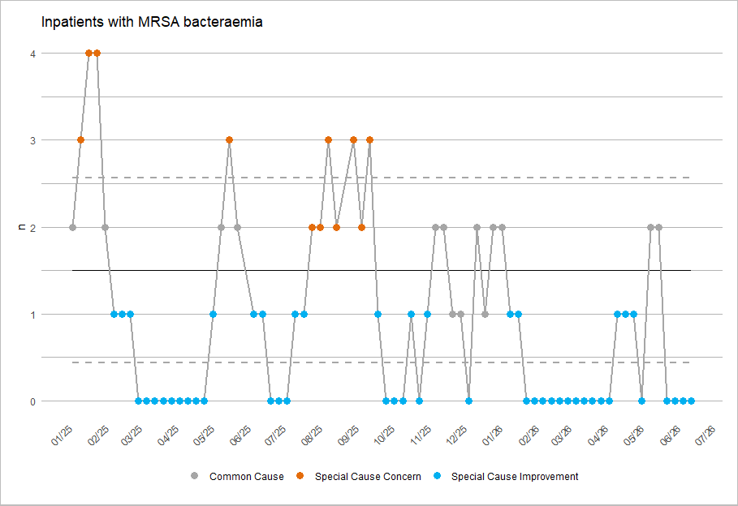
Impact of RAP on MRSA rates
Between 07/01/2025 and 16/06/2026
(~ 1.5 years)
Inpatients with MRSA bacteraemia
(prevalence)
(lower is better)

Slide 29
RAP reliability
Between 07/01/2025 and 16/06/2026 (~ 1.5 years):
Reports were successfully published for 75 out of 77 weeks (97.4%)
Two weeks of missed reporting:
1x summer holidays data science team staffing constraints; and
1x unscheduled lab information management system (LIMS) downtime
No significant modifications to the RAP workflow required throughout

Slide 30
Interpretation
RAP-generated, patient-level feedback constitutes an effective mechanism to achieve rapid and sustained improvements in MRSA admission screening rates.
Relatively-speaking: extremely resource- and time-efficient.

Slide 31
Discussion
The relatively modest baseline compliance with MRSA admission screening compliance is not unexpected
Published benchmarks point at varying performance levels:
Swiss study, baseline compliance rate of 32% (Ref 33)
English study, only 61% of emergency admissions (median 67.3%), screened for MRSA (Ref 34).
Scottish study, audit data from self-selected areas, compliance of 81% (Ref 5).

Slide 32

Conclusions
Beyond MRSA admission screening, RAP can be readily modified to monitor and improve compliance with other time-sensitive measures.
At NUTH, the RAP has been modified to…
… Identify gaps in lipid disorder management & improve genetic screening for inherited rare disorders; and
… Link antimicrobial resistance (AMR) data with inpatient antimicrobial prescriptions; and
… Support pharmacogenetics interventions; and
… Identify penicillin allergy delabelling opportunities; and
… (and shortly also) improve recruitment to clinical trials for patients with bronchiectasis and COPD

Slide 33
Recommendations
Investing in RAP represents a strategic opportunity for healthcare organisations committed to embedding evidence-based practices.
RAP should be further scaled across organisations to achieve sustained, system-wide improvement in multiple dimensions of healthcare safety and quality.

Slide 34
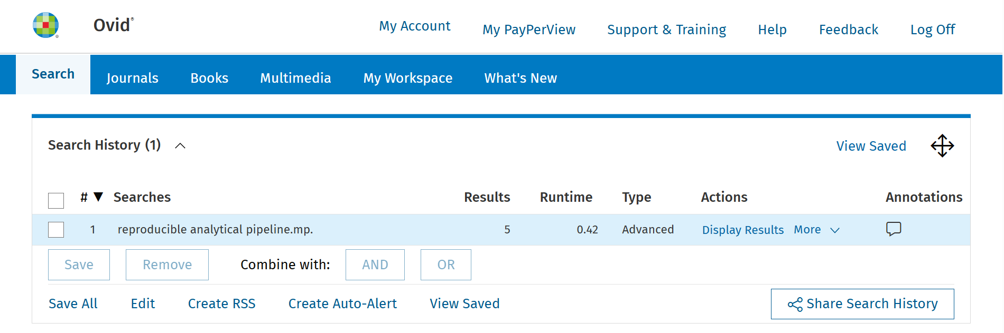
This work has been submitted for publication in peer-reviewed journal
Preprint available on Zenodo:
https://zenodo.org/records/18468788
There are very few peer-reviewed publications on RAP
(n = 5 in Nov 2025)

Slide 35
Thanks for listening!
Daniel Weiand; Paul Bradley; Caroline Cullerton; Geoff Dines;
Joanne Field; Peta Le Roux; Jamie Lupton; Julie Samuel; Chris Plummer

Slide 36
Funding
The NIHR Newcastle Biomedical Research Centre (BRC) is a partnership between Newcastle Hospitals NHS Foundation Trust, Newcastle University, and Cumbria, Northumberland and Tyne and Wear NHS Foundation Trust and is funded by the National Institute for Health and Care Research (NIHR).
This presentation includes details of independent research supported by the NIHR Newcastle Biomedical Research Centre (BRC). The views expressed are those of the author(s) and not necessarily those of the NIHR or the Department of Health and Social Care.

Slide 37
References (1)
1. Siegel JD, Rhinehart E, Jackson M, Chiarello L. 2007 guideline for isolation precautions: Preventing transmission of infectious agents in health care settings. American Journal of Infection Control [Internet]. 2007 Dec;35(10):S65–164. Available from: http://dx.doi.org/10.1016/j.ajic.2007.10.007
2. NHS England. Delivering a standardised approach to screening for MRSA [Internet]. 2025. Available from: https://gettingitrightfirsttime.co.uk/delivering-a-standardised-approach-to-screening-for-mrsa/
3. Dickmann P, Keeping S, Döring N, Schmidt AE, Binder C, Ariño-Blasco S, et al. Communicating the risk of MRSA: The role of clinical practice, regulation and other policies in five european countries. Frontiers in Public Health [Internet]. 2017 Mar;5. Available from: http://dx.doi.org/10.3389/fpubh.2017.00044
4. Coia JE, Duckworth GJ, Edwards DI, Farrington M, Fry C, Humphreys H, et al. Guidelines for the control and prevention of meticillin-resistant staphylococcus aureus (MRSA) in healthcare facilities. Journal of Hospital Infection [Internet]. 2006 May;63:S1–44. Available from: http://dx.doi.org/10.1016/j.jhin.2006.01.001
5. Currie K, King C, McAloney-Kocaman K, Roberts NJ, MacDonald J, Dickson A, et al. Barriers and enablers to meticillin-resistant staphylococcus aureus admission screening in hospitals: A mixed-methods study. Journal of Hospital Infection [Internet]. 2019 Jan;101(1):100–8. Available from: http://dx.doi.org/10.1016/j.jhin.2018.08.006
6. Department of Health. Implementation of modified admission MRSA screening guidance for NHS [Internet]. 2014. Available from: https://assets.publishing.service.gov.uk/government/uploads/system/uploads/attachment_data/file/345144/Implementation_of_modified_admission_MRSA_screening_guidance_for_NHS.pdf
7. NHS England. GIRFT guide to preoperative testing: Adult MRSA screening and suppression/eradication prophylaxis for patients who are on an elective surgical pathway [Internet]. 2025. Available from: https://gettingitrightfirsttime.co.uk/wp-content/uploads/2025/05/GIRFT-Guide-to-preoperative-testing-MRSA-May-2025.pdf
8. Coia JE, Wilson JA, Bak A, Marsden GL, Shimonovich M, Loveday HP, et al. Joint healthcare infection society (HIS) and infection prevention society (IPS) guidelines for the prevention and control of meticillin-resistant staphylococcus aureus (MRSA) in healthcare facilities. Journal of Hospital Infection [Internet]. 2021 Dec;118:S1–39. Available from: http://dx.doi.org/10.1016/j.jhin.2021.09.022
9. May C, Finch T, Rapley T. Normalization process theory. In: Nilsen P, Birken SA, editors. Handbook on implementation science [Internet]. Edward Elgar Publishing; 2020. p. 144–67. Available from: https://www.elgaronline.com/downloadpdf/edcollchap/edcoll/9781788975988/9781788975988.00013.pdf
10. May CR, Mair FS, Dowrick CF, Finch TL. Process evaluation for complex interventions in primary care: Understanding trials using the normalization process model. BMC Family Practice [Internet]. 2007 Jul;8(1). Available from: http://dx.doi.org/10.1186/1471-2296-8-42
11. Nilsen P. Making sense of implementation theories, models and frameworks. Implementation Science [Internet]. 2015 Apr;10(1). Available from: http://dx.doi.org/10.1186/s13012-015-0242-0
12. Murray E, Treweek S, Pope C, MacFarlane A, Ballini L, Dowrick C, et al. Normalisation process theory: A framework for developing, evaluating and implementing complex interventions. BMC Medicine [Internet]. 2010 Oct;8(1). Available from: http://dx.doi.org/10.1186/1741-7015-8-63
13. Goldacre B, Morley J, Hamilton N, et al. Better, broader, safer: Using health data for research and analysis [Internet]. Department of Health; Social Care; 2022. Available from: https://assets.publishing.service.gov.uk/government/uploads/system/uploads/attachment_data/file/1067053/goldacre-review-using-health-data-for-research-and-analysis.pdf
14. Elliott A. Better, broader, safer: Using health data for research and analysis (the goldacre review). Journal of Radiological Protection [Internet]. 2022 Sep;42(3):030101. Available from: http://dx.doi.org/10.1088/1361-6498/ac89f8
15. NHS Digital RAP Community of Practice. What is RAP? https://nhsdigital.github.io/rap-community-of-practice/introduction_to_RAP/what_is_RAP/; n.d.
16. Keegan NM, Vasselman SE, Barnett ES, Nweji B, Carbone EA, Blum A, et al. Clinical annotations for prostate cancer research: Defining data elements, creating a reproducible analytical pipeline, and assessing data quality. The Prostate [Internet]. 2022 May;82(11):1107–16. Available from: http://dx.doi.org/10.1002/pros.24363
17. Newcastle upon Tyne Hospitals NHS Foundation Trust. About newcastle hospitals [Internet]. 2020 [cited 2025 Aug 21]. Available from: https://www.newcastle-hospitals.nhs.uk/about/

Slide 38
References (2)
18. Newcastle upon Tyne Hospitals NHS Foundation Trust. Newcastle hospitals laboratories. https://laboratories.newcastle-hospitals.nhs.uk/; 2025.
19. UKAS. Medical laboratory accreditation - ISO 15189. https://www.ukas.com/accreditation/standards/medical-laboratory-accreditation/; 2025.
20. NHS Digital RAP Community of Practice. Introduction to git. https://nhsdigital.github.io/rap-community-of-practice/training_resources/git/introduction-to-git/; n.d.
21. GitHub. GitHub. GitHub; https://github.com/; 2025.
22. Müller K, Wickham H, James DA, Falcon S. RSQLite: SQLite interface for r [Internet]. 2024. Available from: https://rsqlite.r-dbi.org
23. R Core Team. R: A language and environment for statistical computing [Internet]. Vienna, Austria: R Foundation for Statistical Computing; 2024. Available from: https://www.R-project.org/
24. Allaire J, Dervieux C. Quarto: R interface to quarto markdown publishing system [Internet]. 2024. Available from: https://github.com/quarto-dev/quarto-r
25. Microsoft. Internet information services (IIS) for windows server. https://www.iis.net/overview; 2025.
26. ICO. UK GDPR guidance and resources. ICO; https://ico.org.uk/for-organisations/uk-gdpr-guidance-and-resources/; 2025.
27. Benneyan JC. Statistical process control as a tool for research and healthcare improvement. Quality and Safety in Health Care [Internet]. 2003 Dec;12(6):458–64. Available from: http://dx.doi.org/10.1136/qhc.12.6.458
28. Mohammed MA. Using statistical process control to improve the quality of health care. Quality and Safety in Health Care [Internet]. 2004 Aug;13(4):243–5. Available from: http://dx.doi.org/10.1136/qhc.13.4.243
29. Anhøj J, Hellesøe AMB. The problem with red, amber, green: The need to avoid distraction by random variation in organisational performance measures. BMJ Quality &amp; Safety [Internet]. 2016 Mar;26(1):81–4. Available from: http://dx.doi.org/10.1136/bmjqs-2015-004951
30. NHS England. Making data count [Internet]. 2019. Available from: https://www.england.nhs.uk/publication/making-data-count/
31. Smith T, Reading C, Wellesley-Miller S, Turner Z, Jemmett T, Mainey C, et al. NHSRplotthedots: Draw XmR charts for NHS making data count programme [Internet]. 2025. Available from: https://nhsrplotthedots.nhsrcommunity.com
32. Chen LF, Vander Weg MW, Hofmann DA, Reisinger HS. The hawthorne effect in infection prevention and epidemiology. Infection Control &amp; Hospital Epidemiology [Internet]. 2015 Sep;36(12):1444–50. Available from: http://dx.doi.org/10.1017/ice.2015.216
33. Joubert D, Cullati S, Briot P, Righi L, Grauser D, Ourahmoune A, et al. How to improve hospital admission screening for patients at risk of multidrug-resistant organism carriage: A before-and-after interventional study and cost-effectiveness analysis. BMJ Open Quality [Internet]. 2022 Apr;11(2):e001699. Available from: http://dx.doi.org/10.1136/bmjoq-2021-001699
34. Fuller C, Robotham J, Savage J, Hopkins S, Deeny SR, Stone S, et al. The national one week prevalence audit of universal meticillin-resistant staphylococcus aureus (MRSA) admission screening 2012. Kluytmans J, editor. PLoS ONE [Internet]. 2013 Sep;8(9):e74219. Available from: http://dx.doi.org/10.1371/journal.pone.0074219

